Slide 1

Kopiera en Solution
Richard Chalk, Systementor AB

Slide 2
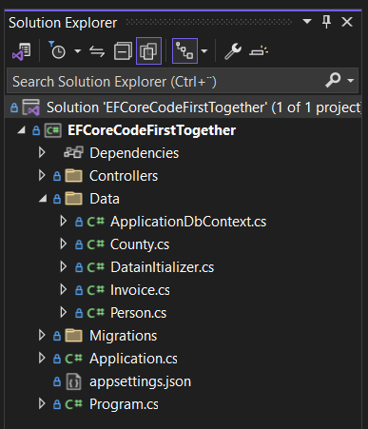

Kopiera en solution
CODE ALONG!
Ibland vill man kopiera en hel solution inklusive alla project och döper om den.
Denna metod är hjälpsam om man
har skapat en template som man
vill använda i flera andra project och man
vill slippa göra om alla steg igen.
Tex. Om man har byggt en
Code First Console app template!

Slide 3
Kopiera en solution
CODE ALONG!
1. Close Visual Studio.
2. Create a copy of your entire solution folder
3. Imagine you want to rename solution from Project1 to Project2.
4. Rename the solution folder from Project1 to Project2 using Windows
Explorer.
5. Rename the project folder from Project1 to Project2 using Windows Explorer.
6. Rename the .csproj file from Project1 to Project2 using Windows Explorer.
7. In the .sln file, right click and open with eg. Notepad.
Edit all instances of Project1 to be Project2.
8. Restart Visual Studio, and everything will work as before, but with the project
in a different directory with the new name.

